Slide 1


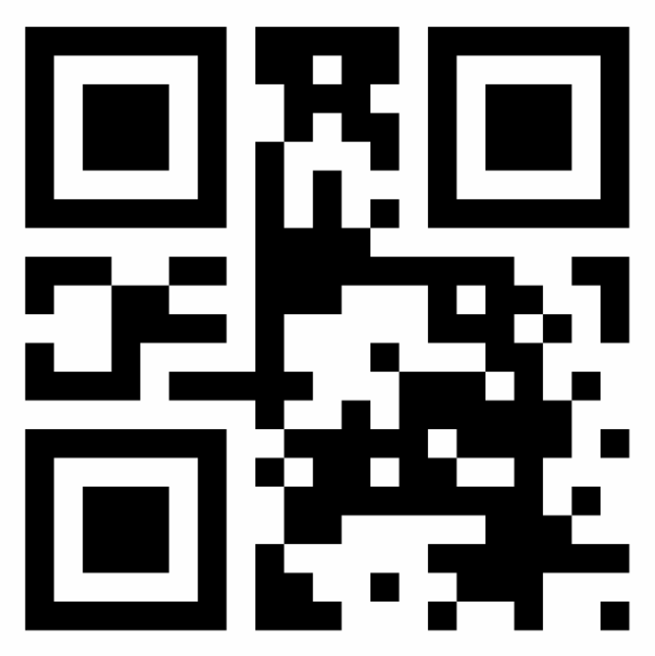



Consumers (aka 3rd Partiers, 3P)
Consumers are customer-facing service providers (e.g., airlines, airports, restaurants). On check-in, users give them their anonymous wallet QR codes. They may validate wallet ownership with a face hash. Consumers ask brokers to ask users to share the vaults containing specific info. On user approval, consumers ask brokers to ask vaults to send the info to them.
Consumers may create credentials for users to download/print, allowing access on checkpoints within their closed circuits.
1
User shows their wallet’s QR to consumers on a device, on paper, or as an URL. The consumer scans user’s face and validates the hash.
Consumers asks the broker for the vaults that store user info related to a set of required information codes, e.g. IATA.ORG/SSR/*.
The broker maps codes to vaults, then asks the wallet to ask the user to approve sharing the vaults (e.g., in app or via SMS).
Concierges send to the 3P the approved vaults for the codes the 3P requested, including any verifiable credentials.
3Ps ask Trusted Graphs if they can trust the given vault’s code responses, and use their public keys to verify the credentials.
Optionally, 3P asks the broker for the vault’s updated metadata and credentials.
Wallets sign a JWT token with the private key, and concierges send it to the vault.
The vault decodes the JWT token with the user’s public key stored on the vault, then asks a Trusted Graph if can trust requests from the given 3P for the given codes.
The vault sends the requested codes, metadata, and expiration dates to the 3P.
The 3P processes the vault’s response and sends to the broker a new 3P checked-in sticker with the confirmed codes.
The broker sends the 3P sticker to the wallet for offline use (paper, SMS, app).
User shows the sticker on closed circuits. 3Ps check signature fraud, the hash and birth for ownership, and code expirations.
2
3
1
W
anonymous
wallet QR
anonymous
3P sticker
S
12
Any Wallet
4
Any Trust Graph
e.g. Japan
3
share vaults?
Closed Circuit
e.g. Tokyo Airport
5
vaults?
7
sign request
vaults' info?
can consumer
trust vault with code X?
3P sticker
6
11
download 3P sticker
7
5
2
6
10
7
trusted: yes/no
public key
disclose
info
8
Any consumer e.g. JP Airlines
4
Any Broker
e.g. Infosys
user’s approved
vaults for codes, and verifiable credentials
9
10
9
8
send vault’s PII info to consumer
Any Vault
e.g. French Mobility
can vault
trust consumer requests for code X?
Any Trust Graph
e.g. Infosys
11
12

